Slide 1
Machine learning
WORK 2
Group Member:
MUKAYIGIRE Berthe 24RP15432
NIYIGABA Claude 24RP14647
TWIZERIMANA Jean claude 24RP13964

Slide 2
Q 1 regression analysis
Regression analysis is a statistical method used to examine the relationship between a dependent variable (outcome) and one or more independent variables (predictors).
Its primary purpose is to model this relationship to understand how changes in the independent variables affect the dependent variable.
Regression analysis allows for making predictions, identifying trends, and understanding the strength and nature of relationships within data.

Slide 3
Key Purposes of Regression Analysis
Prediction and Forecasting: Helps predict the value of the dependent variable based on known values of independent variables.
Estimation of Relationships: Quantifies the strength and type of relationship between variables.
Testing Hypotheses: Assists in determining whether there is a statistically significant relationship between variables.
Identifying Influential Factors: Identifies which independent variables are most influential in determining the dependent variable.

Slide 4
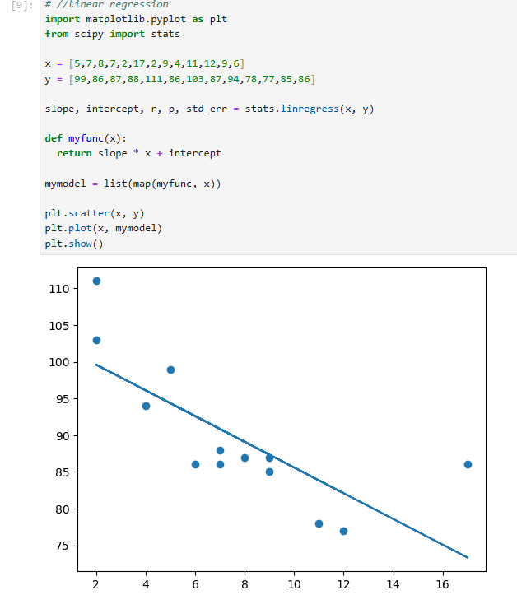
Cont, …

Slide 5
Q 2 difference between simple linear regression and multiple linear regression
In simple linear regression, there is one independent variable (predictor) and one dependent variable (outcome). It models a straight-line relationship between the two, showing how changes in the single independent variable affect the dependent variable.
Simple Linear Regression: Examines the relationship between two variables.
For example, predicting a person's weight based only on their height.
In multiple linear regression, there are two or more independent variables used to predict the dependent variable. This allows the model to account for multiple factors that may influence the outcome.
Multiple Regression: Involves two or more independent variables.
For example, predicting a person's weight based on their height, age, and exercise habits.

Slide 6
Q 3 polynomial regression differ from linear regression
Polynomial regression is a type of regression analysis that models a non-linear relationship between the independent variable(s) and the dependent variable by adding powers of the independent variable(s). In other words, it fits a curved line to the data instead of a straight line, as in linear regression.
Linear regression is a statistical modeling technique used to estimate the relationship between a dependent variable and one or more independent variables

Slide 7
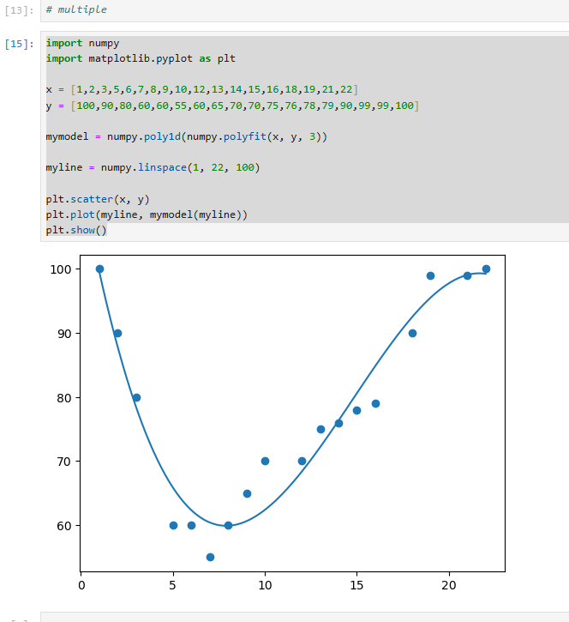
Cont…

Slide 8
Key differences
Nature of Relationship:
Linear Regression: Assumes a straight-line relationship between the independent variable(s) and the dependent variable.
Polynomial Regression: Models a curved relationship by using higher powers (e.g., squared, cubed) of the independent variable(s).
Equation Form:
Linear Regression: Y=b0+b1XY = b_0 + b_1XY=b0​+b1​X
Polynomial Regression: Y=b0+b1X+b2X2+b3X3+⋯+bnXn, Y = b_0 + b_1X + b_2X^2 + b_3X^3 + \dots + b_nX^n, Y=b0​+b1​X+b2​X2+b3​X3+⋯+bn​Xn, where n is the degree of the polynomial.
Application:
Linear Regression is used when the data has a clear linear trend.
Polynomial Regression is useful when the data shows a curved or more complex pattern that a straight line can’t fit well.

Slide 9
Q4. logistic regression, and what types of problems is it suitable for?
Logistic regression is a statistical model used to predict the probability of a binary or categorical outcome, where the dependent variable has two possible classes (e.g., yes/no, 0/1, success/failure). Unlike linear regression, which predicts a continuous value, logistic regression predicts probabilities that are then converted into binary outcomes, typically using a threshold (e.g., 0.5).
Key Features of Logistic Regression:
Non-Linear Transformation: Logistic regression uses the logistic (sigmoid) function to squeeze predictions between 0 and 1, making it ideal for probabilities.
Binary Classification: It’s most commonly used for binary classification problems, but there are extensions (e.g., multinomial logistic regression) for multiple categories.

Slide 10
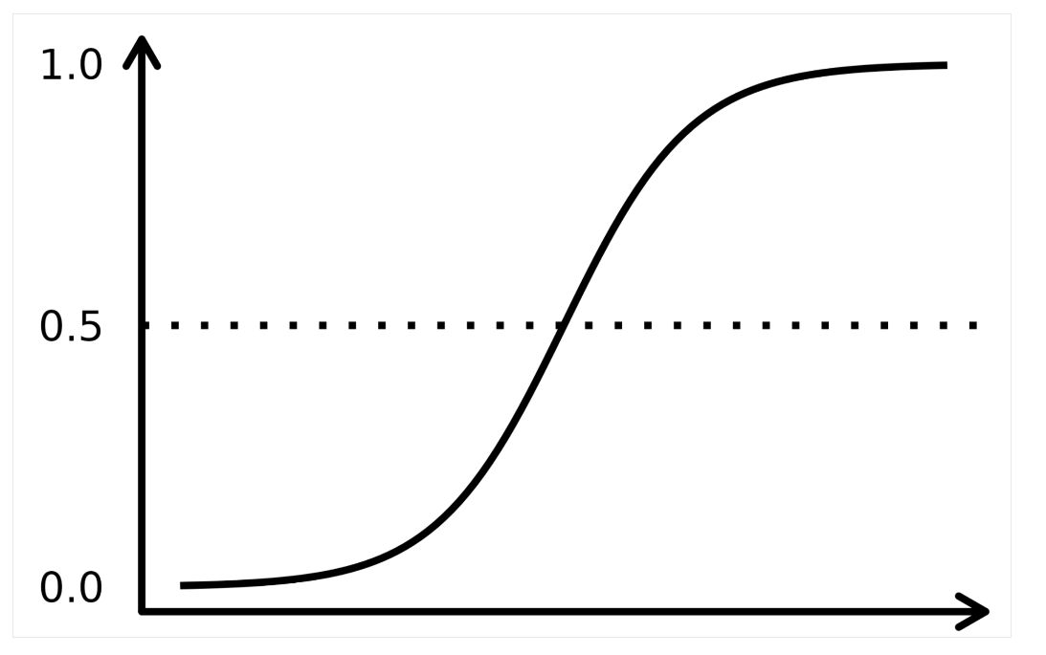
Cont…
logistic regression

Slide 11
Q5. The purposes of regularization techniques such as ridge regression and lasso Regression
Regularization techniques like ridge regression and lasso regression can help mitigate the effects of multicollinearity by shrinking the coefficients towards zero or setting some coefficients to exactly zero.
Lasso regression, in particular, can automatically perform feature selection by setting some regression coefficients to exactly zero.
This helps identify the most important predictors in the model and improves the model's interpretability.
In summary, the main purposes of regularization techniques like ridge regression and lasso regression are to prevent overfitting, handle multicollinearity, and perform feature selection, ultimately leading to more robust and interpretable regression models.

Slide 12
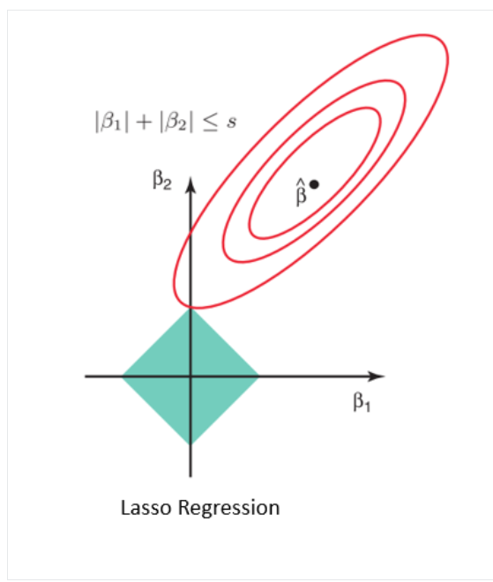
Cont …

Slide 13
Q6. Describe the concept of overfitting in regression analysis. How can it be addressed?
Overfitting in regression analysis occurs when a model learns the training data too closely, capturing noise and random fluctuations rather than the true underlying pattern.
This results in excellent performance on training data but poor generalization to new, unseen data.
How to Address Overfitting:
Use Regularization (e.g., ridge or lasso regression) to penalize large coefficients.
Reduce Model Complexity by using simpler models or fewer features.
Increase Training Data to help the model better generalize.
Use Cross-Validation to tune the model and test its performance on separate data sets.

Slide 14
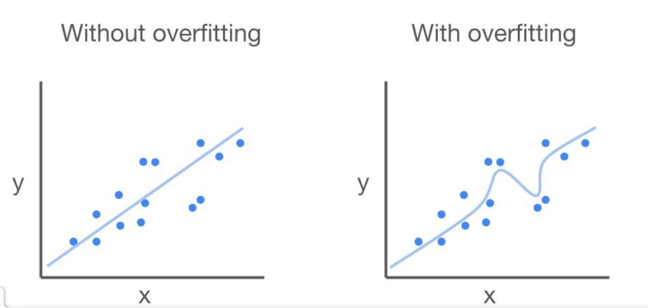
Cont…

Slide 15
Q7. Difference between homoscedasticity and heteroscedasticity
In the context of regression analysis, the difference between homoscedasticity and heteroscedasticity is:
Homoscedasticity: The variance of the residuals is constant across all levels of the independent variables. This is an assumption of linear regression.
Heteroscedasticity: The variance of the residuals is not constant across all levels of the independent variables. This violates the assumption of homoscedasticity.
In summary, homoscedasticity refers to equal variance, while heteroscedasticity refers to unequal variance of the residuals in a regression model.

Slide 16
Q8. How does time series regression differ from cross-sectional regression?
Cross-sectional regression:
Uses data from different entities (e.g., individuals, companies) at a single point in time.
Focuses on analyzing relationships between variables across these entities.
Time series regression:
Uses data from a single entity (e.g., a country, a stock) over multiple time periods.
Focuses on analyzing relationships between variables over time for that single entity.
The key difference is the data structure - cross-sectional looks at differences between entities, while time series looks at changes over time for a single entity.

Slide 17
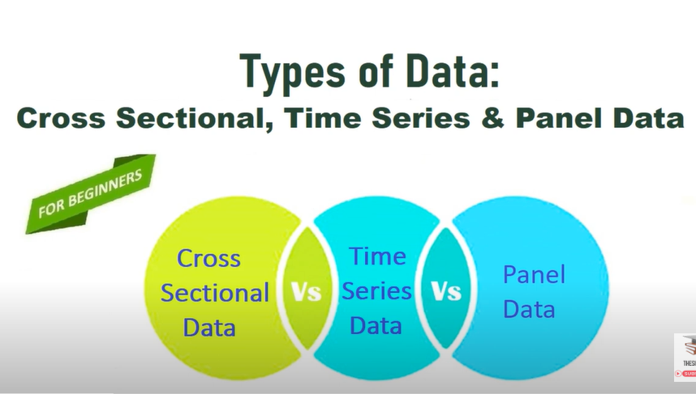
Cont…

Slide 18
Q9. Multicollinearity in regression analysis and its potential impact on the model
Multicollinearity is a phenomenon that occurs in multiple regression analysis when two or more independent variables (predictors) in the regression model are highly correlated with each other.
In other words, multicollinearity exists when the independent variables are not independent, but instead, they share a significant amount of common variance.
Potential Impact on the Regression Model:
Unstable Coefficient Estimates: Small data or model changes can cause large swings in coefficient values, making them unreliable and hard to interpret.
Inflated Standard Errors: Standard errors increase, making coefficient estimates less precise and reducing confidence in statistical significance.
Difficulty Assessing Predictor Importance: Multicollinearity confounds variable effects, making it hard to determine each predictor's unique impact on the outcome.
Model Instability:The model becomes sensitive to adding or removing variables, causing large changes in estimates and reducing reliability.
Violation of Regression Assumptions:Multicollinearity violates the independence assumption, leading to biased estimates and reducing confidence in conclusions.

Slide 19
Q10. What are the key assumptions of linear regression, and why are they important ?
Linearity: The relationship between the independent and dependent variables should be linear. This is important for accurate model estimation and interpretation.
Independence: The observations should be independent of each other. Violation of this assumption can lead to biased standard errors and incorrect statistical inferences.
Homoscedasticity: The variance of the residuals should be constant across all levels of the independent variables. Heteroscedasticity (non-constant variance) can lead to biased standard errors.
Normality: The residuals should be normally distributed. This is important for valid hypothesis testing and confidence interval construction.
No multicollinearity: The independent variables should not be highly correlated with each other. Multicollinearity can lead to unstable and unreliable coefficient estimates.

Slide 20
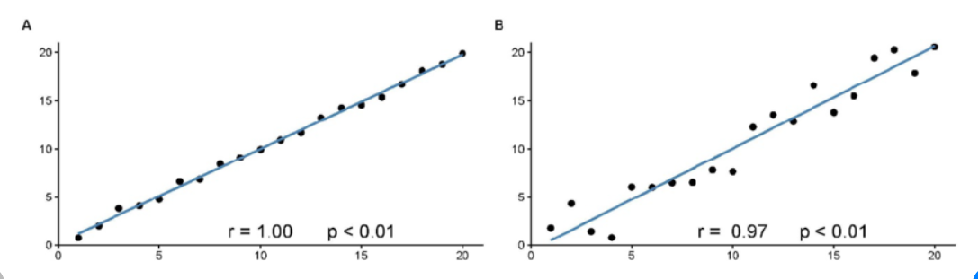
Cont…

Slide 21
Thank you

